Slide 1
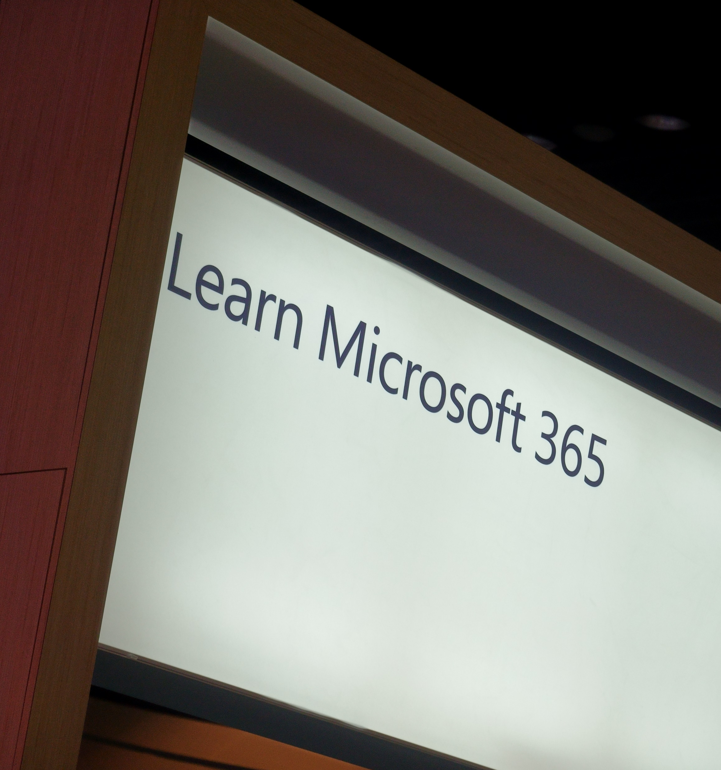


Microsoft Information Protection
Demystified

Slide 2







In a world without boundaries, data lives and travels everywhere
OPPORTUNITY

Slide 3
Protect your sensitive data – wherever it lives or travels
Microsoft Information Protection
Discover
Classify
Protect
Monitor
Across
Devices
Apps
Cloud services
On-premises
Notes:
EMS Overview
© 2014 Microsoft Corporation. All rights reserved. Microsoft, Windows, Surface and other product names are or may be registered trademarks and/or trademarks in the U.S. and/or other countries. The information herein is for informational purposes only and represents the current view of Microsoft Corporation as of the date of this presentation. Because Microsoft must respond to changing market conditions, it should not be interpreted to be a commitment on the part of Microsoft, and Microsoft cannot guarantee the accuracy of any information provided after the date of this presentation. MICROSOFT MAKES NO WARRANTIES, EXPRESS, IMPLIED OR STATUTORY, AS TO THE INFORMATION IN THIS PRESENTATION.
1/24/2019
3

Slide 4
Converging and simplifying with Microsoft Information Protection
Content Discovery
Transport rules
SharePoint DLP
FCI
AIP
MCAS
Labeling and classification
FCI
Exchange classification
SharePoint tagging
AIP
Encryption and protection
Rights Management Services
EFS
Office 365 Message Encryption
WIP
Tracking and monitoring
RMS logs
Classification logs
Office 365 Compliance Center
MCAS alerts
WDATP
Content detection
Microsoft Information Protection
Labeling and classification
Microsoft Information Protection
Encryption and protection
Microsoft Information Protection
Tracking and monitoring
Microsoft Information Protection

Slide 5
Microsoft’s information protection solutions
AZURE INFORMATION PROTECTION
Classify, label & protect files – beyond Office 365, including on-prem & hybrid
MICROSOFT CLOUD APP SECURITY
Visibility into 15k+ cloud apps, data access & usage, potential abuse
OFFICE 365 DLP
Prevent data loss across Exchange Online, SharePoint Online, OneDrive for Business
DETECT
OFFICE 365 ADVANCED SECURITY MANAGEMENT
Visibility into Office 365 app usage and potential data abuse
OFFICE APPS
Protect sensitive information while working in Excel, Word, PowerPoint, Outlook
Microsoft’s Information Protection Technologies
WINDOWS INFORMATION PROTECTION/WD ATP
Separate personal vs. work data on Windows 10 devices and prevent work data from traveling to non-work locations
MONITOR
CLASSIFY
ISV APPLICATIONS
Enable ISV partners to consume labels, apply protection
MESSAGE ENCRYPTION
Send encrypted emails in Office 365 to anyone – inside or outside of the company
OFFICE 365 ADVANCED DATA GOVERNANCE
Apply retention and deletion policies to sensitive and important data in Office 365
PROTECT
CONDITIONAL ACCESS
Control access to files based on policy, such as identity, machine configuration, geo location
SHAREPOINT & GROUPS
Protect files in libraries and lists

Slide 6
Microsoft information protection solutions
AZURE INFORMATION PROTECTION
Classify, label & protect files – beyond Office 365, including on-premises & hybrid
CONDITIONAL ACCESS
Control access to files based on policy, such as identity, machine configuration, geo location
MICROSOFT CLOUD APP SECURITY
Visibility into 15k+ cloud apps, data access & usage, potential abuse
OFFICE 365 APPS
Protect sensitive information while working in Excel, Word, PowerPoint, Outlook
OFFICE 365 DATA LOSS PREVENTION
Prevent data loss across Exchange Online, SharePoint Online, OneDrive for Business
MICROSOFT INFORMATION PROTECTION
SHAREPOINT & GROUPS
Protect files in libraries and lists
OFFICE 365 MESSAGE ENCRYPTION
Send encrypted emails in Office 365 to anyone inside or outside of the company
AZURE SECURITY CENTER INFORMATION PROTECTION
Classify & label sensitive structured data in Azure SQL, SQL Server and other Azure repositories
Discover | Classify | Protect | Monitor
WINDOWS INFORMATION PROTECTION
Separate personal vs. work data on Windows 10 devices, prevent work data from traveling to non-work locations
SDK FOR PARTNER ECOSYSTEM & ISVs
Enable ISVs to consume labels, apply protection
OFFICE 365 ADVANCED DATA GOVERNANCE
Apply retention and deletion policies to sensitive and important data in Office 365
ADOBE PDFs
Natively view and protect PDFs on Adobe Acrobat

Slide 7
Information Protection

Slide 8

Information Protection & Governance
Data growing at exponential rate
Unified approach
Comprehensive policies to protect and govern your most important data – throughout its lifecycle
Discover
Classify
Label
Unified approach to discover, classify & label
Automatically apply policy-based actions
Proactive monitoring to identify risks
Broad coverage across locations
Apply label
Sensitivity
Retention
Encryption
Restrict Access
Watermark
Header/Footer
Retention
Deletion
Records Management
Archiving
Monitor
Sensitive data discovery
Data at risk
Policy violations
Policy recommendations
Proactive alerts
Devices
Apps
Cloud services
On-premises
ISVs, 3rd-party

Slide 9
Data Leakage
Your information protection needs
DEVICE PROTECTION
LEAK PROTECTION
DEVICE PROTECTION
DATA SEPARATION
DATA SEPARATION
SHARING PROTECTION
LEAK PROTECTION
SHARING PROTECTION
BitLocker enhancements in Windows 8.1
InstantGo
3rd party adoption
Azure Information Protection
Office 365
BitLocker
Windows Information Protection

Slide 10


Windows information protection
Integrated protection against accidental data leaks
Protects data at rest locally and on removable storage.
Common experience across all Windows 10 devices with copy and paste protection.
Corporate vs personal data identifiable wherever it rests on the device and can be wiped.
Since Windows 10 Version 1607
Prevents unauthorized apps from accessing business data and users from leaking data via copy and paste protection.
Seamless integration into the platform, No mode switching and use any app.

Slide 11

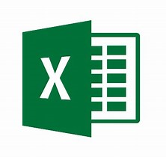

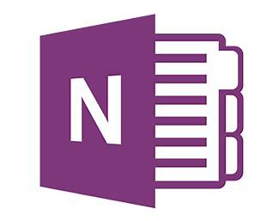

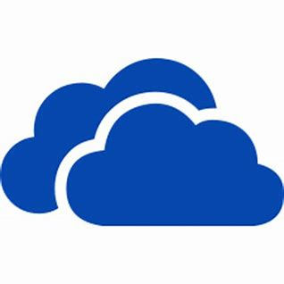









Enlightened Applications

Slide 12
Unenlightened Applications – How to manage
Option 1: Use Allow policy
Caution: Auto-encrypts all files touched
Intended for Line of Business (LOB) apps
Can include in policy for fully managed devices
Option 2: Use Exempt policy
WIP rules don’t apply to the app
Access work without impacting personal data
Option 3: Enlighten the app
See: http://aka.ms/wip-dev-guide

Slide 13
WIP & AIP – v1703: USB roaming
What you get
WIP uses Azure RMS key on removable storage
Auth to Azure RMS, opens on v1703 and later PCs
Tenant-wide user access by default
Can adjust access with RMS templates
What you need
Configure WIP to use AIP for removable media (E3 subscription)
Creators Update (v1703) or later client

Slide 14
WIP & AIP – v1809: WIP as label outcome
What you get
WIP applied to labeled files on create/modify/arrival
Set via Office/M365 Security & Compliance Center (SCC)
What you need
Office/M365 Security & Compliance Center
Windows 10 v1809 client
Windows Defender Advanced Threat Protection (E5 subscription)

Slide 15
Better Together Vision: WIP+AIP+WD ATP
Going forward, AIP and WD ATP benefit WIP & vice versa
Ideas:
WD ATP could use WIP for …auditing, insider threat detection, halting exfiltration, etc.
More client classification, labeling, WIP & AIP protection
WIP could help trigger AIP sharing scenarios
More data would get protected automatically

Slide 16
AIP
Scanner

Slide 17




AIP Scanner capabilities
Scans on-perm repositories: file shares, NAS or any other CIFS based repositories, or SharePoint Server
Discover data in the scanned repositories and match it against AIP policy (detect MCE sensitive info types, custom patterns and default label)
Labels and protects the discovered data per AIP policy
Create a report of discovered data, including the matched conditions for found patterns

Slide 18
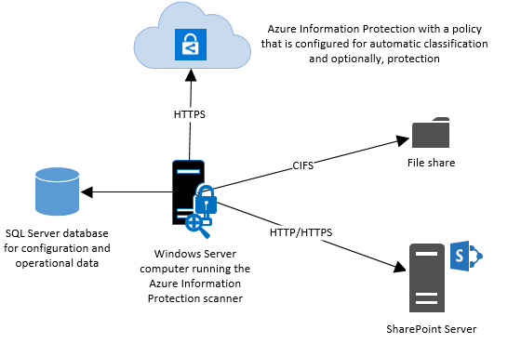
Installing the AIP Scanner in less than five minutes

Slide 19
AIP Scanner in Discovery mode with All Content Types
AIP Scanner can be configured in discovery mode
No need to create labels or assign content types
Point it to a document repository and it will find out all content types
Reports can be queried by data type to filter out the relevant or regulated types
Configure scanner with the DiscoverInformationTypes flag
E.g.:
PS C:\> Set-AIPScannerConfiguration -Enforce Off -DiscoverInformationTypes All
More about the Scanner in today’s theater session THR3005 at 1:40pm

Slide 20
Identity is the control plane
Identity

Slide 21







Is the center of security
Identity System
On-premises /
Private cloud

Slide 22
Comprehensive Enterprise Mobility+Security capabilities
Identity lifecycle | Azure AD Connect, Provisioning from HR, B2B Invitations, SAML JIT
Entitlement management | Azure AD Entitlement management
Access requests | Self-service group management, Self-service access and requests, MyApps
Workflow | Approval workflows for self-service, admin role activation approval
Policy | Conditional Access, Identity Protection, Entitlement access policies
Access certification | Recurring access reviews for group membership, app access, admin role assignments
Fulfillment | Automatic provisioning for groups, SaaS and on-premises apps (SCIM), SharePoint Online
Password management | Self-services password management
Device management | Azure AD join, Intune, per-device terms of use
UEBA and CASB | Azure ATP, Cloud App Security
Data Governance | Azure Information Protection
Privileged Access | Time-limited and scoped access with Azure AD PIM (and Office 365 PAM)

Slide 23










Microsoft Threat Protection
Azure Active Directory
Azure Advanced Threat Protection
Microsoft Cloud App Security
1
Identities: Validating, verifying and protecting both user and admin accounts
Microsoft Intune
Windows 10
Azure Security Center
2
Endpoints: protecting user devices and signals from sensors
3
User Data: evaluating email messages and documents for malicious content
Windows Defender Advanced Threat Protection
Office Advanced Threat Protection
Office Threat Intelligence
4
Cloud Apps: protecting SaaS applications and their associated data stores
Windows Server
Linux
Exchange Online Protection
SQL Server
5
Infrastructure: protecting servers, virtual machines, databases and networks across cloud and on-premises locations

Slide 24


Azure AD conditional access
Conditions
Controls
40TB
Allow access
Users
Session Risk
Machine learning
3
Limit access
Devices
On-premises apps
Require MFA
Real time Evaluation
Engine
Location
Force password reset
******
Policies
Effective policy
Web apps
Apps
Deny access

Slide 25
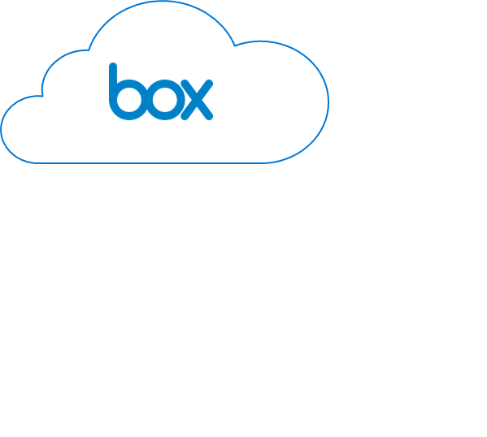





CONDITIONAL ACCESS APP CONTROL
Microsoft is better together!
Cloud App Security integrates with:
Azure Active Directory
Azure Information Protection
Microsoft Intune
to protect any app in your organization.
Microsoft Azure
Active Directory
Seems good
Seems bad
Microsoft Cloud App Security
Analyze Session Risk
Check device
compliance with Intune
Check user behavior
Check user organization
Check location
Enforce Relevant Policies with Conditional Access App Control
Protect downloads from unmanaged devices with AIP
Monitor and alert on actions when user activity is suspicious
Enforce read-only mode in applications for partner (B2B) users
Require MFA and define session timeouts for unfamiliar locations
BOX.US.CAS.MS

